Slide 1
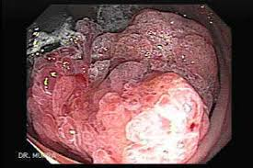
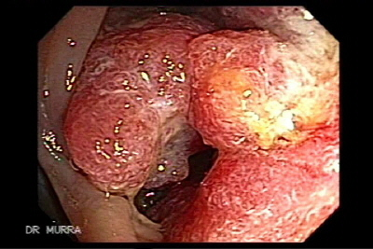
Colorectal Cancer: What we need to know! Who is at risk?
Chinemerem Okwara, MD

Slide 2
Outline
Introduction
Colorectal cancer in individuals of African descent
Risk Factors for Colon cancer
Screening for Colorectal Cancer
Stool based testing
Colonoscopy
Pathophysiology
Polyps
Adenoma-carcinoma sequence
Management
Staging
Surgery
chemo

Slide 3
Introduction
Colon cancer is the 4th most common newly diagnosed internal cancer overall in the USA (Behind prostate, breast and lung).
It is the 3rd most common cause of cancer related death in the USA.
Colon cancer incidence rates are similar between men and women in the USA , but there is a male predominance worldwide.
The lifetime risk of dying from colon cancer in the USA is 2.5%.
Globally, colon cancer is the third most common cancer in men and second most common in women.
If diagnosed at an early stage, 5-year survival is 90%. However less than 40% of cases are diagnosed at localized stage.
Notes:
Colon cancer used interchangeably with colorectal cancer.
S/F and ACG article

Slide 4
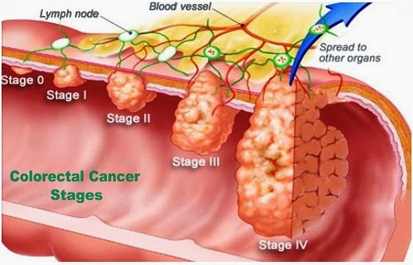

Slide 5
Symptoms
Colon cancer could grow without any symptoms until at an advanced stage.
Possible symptoms include rectal bleeding related to an ulcerated and friable tumor/mass.
This can be seen in lab studies as iron deficiency anemia. (Microcytic)
With significant growth, the tumor/mass can obstruct the colon lumen and cause symptoms of obstruction.
This could result in abdominal pain, distension of abdomen, constipation with PENCIL THIN STOOLS (small caliber stools).

Slide 7
Men
Women

Slide 8
Male
Female
Blacks have increased risk of death from colon cancer in both males and females.

Slide 9
Notes:
Colorectal Cancer in African Americans. Williams et al.
Clinical and Translational Gastroenterology (2016) 7, e185; doi:10.1038/ctg.2016.36

Slide 10
Colorectal cancer (CRC) in Blacks
Overall colon cancer incidence and mortality has declined, but unfortunately blacks continue to have higher incidence as well as mortality.
The overall decline in incidence and mortality could be related to institution/implementation of colon cancer screening.
A population-based retrospective cohort analysis of the SEER registry found that patients under 50 with CRC were more likely to be African American (14.8% vs. 12%) or American Indian/Alaska Native (10.6% vs. 8.5%), which was statistically significant with a P<0.001.
This information and other research data prompted recommendation for starting colon cancer screening at 45 for blacks instead of 50 for the other average risk population.

Slide 11
Why do blacks have higher Incidence and Mortality?
Likely multifactorial
Lifestyle factors are likely contributors including:
Diet
Obesity
Physical activity
Decreased screening***
Sometimes physicians fail to recommend screening to the patients.

Slide 12
Risk Factors
Notes:
Selenium possesses anti-oxidant properties.
Aspirin benefit may require 10 yrs of use (studies have demonstrated a reassuring benefit for aspirin use, 75 mg). RCT with daily use of 81mg ASA decreased adenoma occurrence by 19% and advanced adenoma by 41%.
Studies of NSAID (Sulindac) on FAP patients showed efficacy. (Effect may fade if NSAID is stopped).
A double blind placebo controlled RCT showed efficacy for high dose Celecoxb (28% polyp reduction in 6 months for FAP pt. FDA approved for FAP patients. Celecoxib effect seems to be dose dependent. Cox-2 inhibitors carry risk of cardiovascular adverse effects (attributed to increased thrombosis).
Calcium and folate benefit with conflicting data.
Statin benefit is based on observational studies (no robust evidence yet)
Curcumin/Tumeric has been shown to have benefits in mice studies. (decreases inflammation and expression of Cox-2)
Heterocyclic amines (HCAs) are the carcinogenic and mutagenic chemicals formed from cooking muscle meats such as beef, pork, fowl, and fish. HCAs form when amino acids and creatine react at high cooking temperatures and are formed in greater quantities when meats are overcooked or blackened.

Slide 13
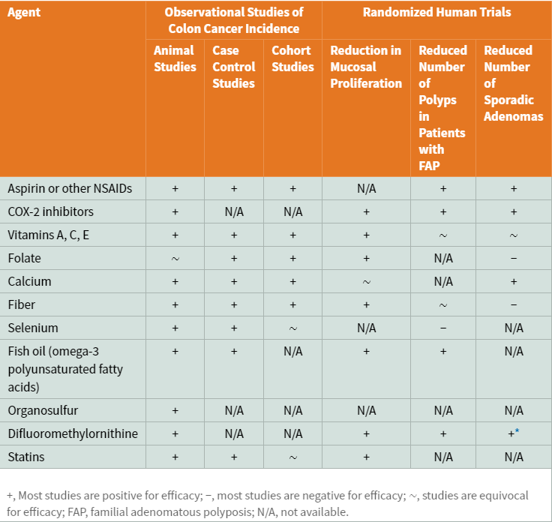
Notes:
Quality of evidence for different factors affecting colon cancer risk

Slide 14
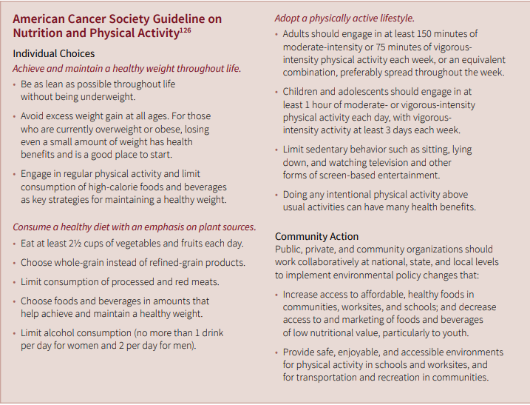

Slide 15
Screening for colon cancer: When?
In most average risk patients (no family history, no genetic factors or disease increasing risk (IBD)) screening should begin at age 50.
For African Americans/Blacks, screening is recommended at age 45.
The American Cancer Society has recommended universal screening starting at age 45 for everyone.
This is based on increased incidence of early colon cancer.
This recommendation has not yet been adopted by the gastroenterology organizations.
For a patient with a family history of colon cancer, screening should begin at age 40 or 10 years before age of diagnosis (which ever is sooner).
5 yr interval
Family history (in a first degree relative) of advanced adenomatous polyp (> 1 cm) should also start screening at age 40 or 10 years before diagnosis in the family member.
5 year interval
Some earlier starting times are possible for other genetic conditions that increase risk of colon cancer.

Slide 16
Screening for Colon cancer: How?
Non-invasive
Stool based
Guaiac FOBT (gFOBT)
FIT*
FIT-DNA Test (COLOGUARD)
Imaging
CT Colonography*
Barium Enema (fallen out of favor)
Capsule colonoscopy
No interventional capability
Invasive
Colonoscopy*
Flexible sigmoidoscopy
Notes:
Septin9 assay blood test only 48% sensitivity for CRC and none for precancerous polyps.

Slide 17
FIT (Fecal Immunochemical Test)
Cancer detection test for average risk patients.
Not for high risk patients with family history or genetic syndrome.
Should be done annually if negative.
Test utilizes antibodies specific for human hemoglobin. This makes the test sensitive for bleeding lesions in the colon (Cancer or bleeding polyps)
A positive test requires a colonoscopy follow up
Notes:
gFOBT detection of blood is dependent on heme in feces.
gFOBTs are not sensitive to small bleeds, specificity can be affected by diet or drugs.
FIT can be quantitative (determines degree of positivity).
FITs are analytically more specific than gFOBT and not subject to the factors known to interfere with gFOBT. They are also selective for colorectal bleeding since globin from the upper gastrointestinal tract is degraded readily by digestive proteolytic enzymes, with a study showing that up to 100 mL of ingested blood was not detected by some immunochemical methods but was by gFOBT.

Slide 18
FIT-DNA (COLOGUARD) (Multitargeted stool DNA testing)
Also for average risk patients
Combination of FIT with testing for altered DNA biomarkers in cells shed into the stool.
Should be done every 3 years if negative.
Cologuard video
https://www.youtube.com/watch?v=U-EvbGM_5Qc
Increased sensitivity vs FIT means more false positive tests.
A positive test requires a follow up colonoscopy
Notes:
Higher sensitivity than FIT, but less Specific than FIT which results in More False Positives

Slide 19
CT Colonography
For average risk patients
Can also be used for incomplete colonoscopies
Best for detecting lesions > 1 cm (10 mm)
Needs a bowel prep (cleansing), requires colon insufflation with CO2 per rectum
CT scan while laying down on the left side
Video
https://www.youtube.com/watch?v=bJ7cYNaKFzM
3-D software allows examination of colon.
If a polyp >1 cm is detected, then the patient will require a colonoscopy for removal.
Does not require sedation, so no driving restriction.
Should be done every 5 years if normal/negative.
Notes:
Fast
Good for detecting lesions 1cm or larger. (comparable to colonoscopy for detecting lesions > 1 cm)
For average risk patients only (not high risk)
https://www.youtube.com/watch?v=5Xj7YznTrG8

Slide 20
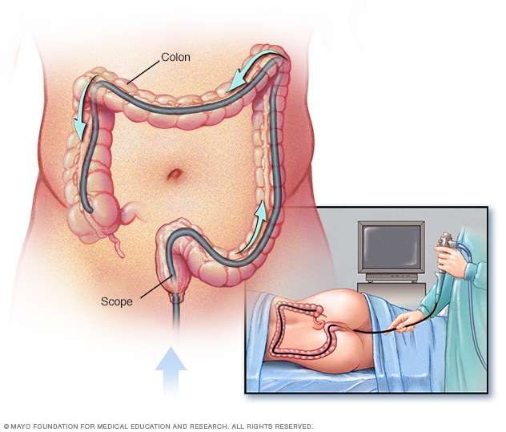
Colonoscopy
A bowel prep (Cleansing is required)
Removal of precancerous polyps prevents development of colon cancer.
Allows direct visualization of the colon mucosa.
Allows interventions such as polyp removal at the time of the procedure.
Requires sedation
The patient cannot drive or operate machinery the day of the procedure
A driver is needed

Slide 21
A normal colonoscopy should be repeated at an interval of every 10 year with some exceptions.
A poor prep quality may shorten the interval
Family history of colon cancer shortens the interval to 5 years
A genetic condition predisposing to colon cancer shortens the interval

Slide 22
Colonoscopy video
https://www.youtube.com/watch?v=eCPySqbIk8U
1:32 – normal colon
7:51 – Polyp
10:35 – Large polyp

Slide 23
Notes:
JAMA

Slide 26
Pathophysiology: How does colon cancer develop?
Cancer development is a multistage process
It begins with abnormal cell proliferation
Normally cells of the colon mucosa divide and proliferate at the deeper levels
This process is meant to replenish natural sloughing of mucosa from passage of intraluminal contents. (similar to skin shedding).
As the cells move up to the upper layers, there should be decreased proliferation and increased differentiation. (differentiated cells have defined function and should no longer divide)

Slide 27
Colorectal cancer are associated with accumulation of genetic alterations
Genetic changes leading to colon cancer may be categorized into 3 major classes:
Alterations in proto-oncogenes (results activation of proliferative pathways)
Loss of tumor suppressor gene activity (loss of control cell growth)
Abnormalities in genes involved in DNA mismatch repair (MMR)
Notes:
Image is of an intestinal cells but demonstrates concept of differentiation well.

Slide 28
Carcinomas arise from an accumulation of events, many of which have been defined. Alterations in APC or DNA mismatch repair genes may be inherited in the germline (familial adenomatous polyposis or Lynch syndrome, respectively) or may be acquired after birth (somatic mutations).
Colorectal carcinomas (CRCs) may also arise as the result of different pathways involving genomic and epigenetic instability. These include chromosomal instability (CIN), microsatellite instability (MSI), CpG island methylator phenotype (CIMP), and global hypomethylation.
These are distinct pathways by which CRCs arise and are associated with unique molecular features (see also Fig. 127-8). Images in this figure depict the traditional sequence of adenoma to carcinoma. An alternative “serrated pathway” involves gene silencing through a combination of epigenomic gene silencing and gene mutation.

Slide 29
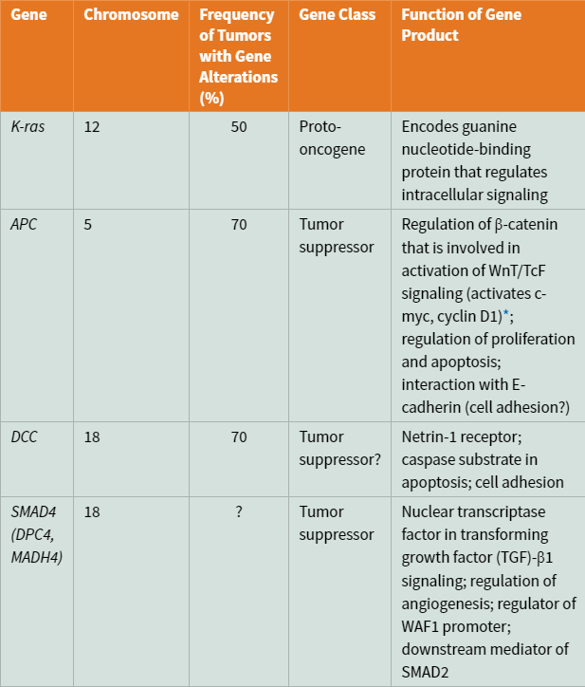
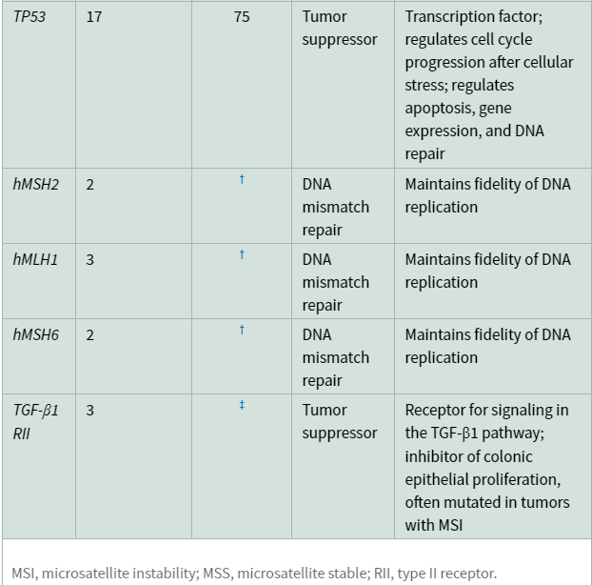

Slide 30
Management/ Treatment
Management of colon cancer depends on stage of the tumor at diagnosis
A cross sectional imaging study such as a CT scan is usually ordered to evaluate the extent of the disease.
A lab test CEA (carcinoembryonic antigen) may be ordered
Surgical resection is the treatment of choice when the cancer is not metastatic (not spread).
Surgery may still be considered in presence of metastasis to treat obstructive symptoms or bleeding complications.

Slide 31
Lymph nodes around the cancer site are usually removed at the time of surgery to check for evidence of cancer.

Slide 32
Staging of colon cancer

Slide 33
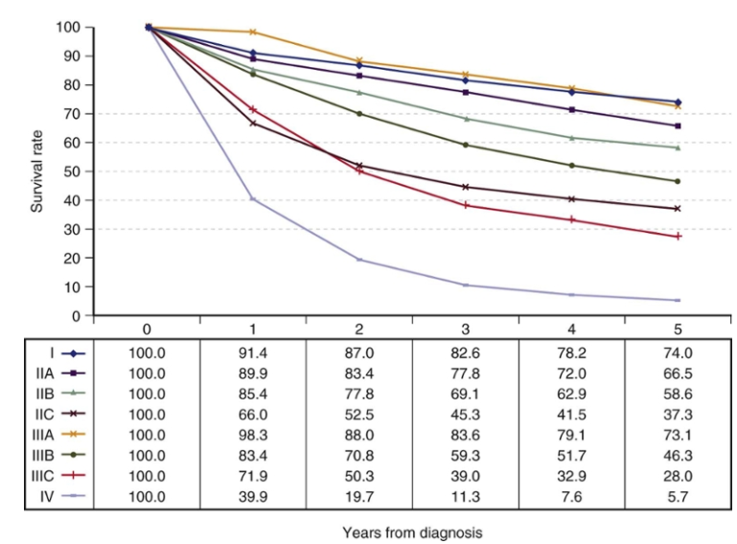
Notes:
Prognosis based on stage at diagnosis
Observed survival rates by stage for 28,491 cases with adenocarcinoma of the colon. Data from the SEER 1973-2005 Public Use File diagnosed in years 1998-2000. Stage I: 7417; Stage IIA: 9956; Stage IIB: 997; Stage IIC: 725; Stage IIIA: 868; Stage IIIB: 1492; Stage IIIC: 2000; and Stage IV: 5036. Figure demonstrates the interaction among T and N classifications and number of positive lymph nodes.
(From American Joint Committee on Cancer. AJCC cancer staging handbook. 7th ed. New York: AJCC; 2010.)

Slide 35
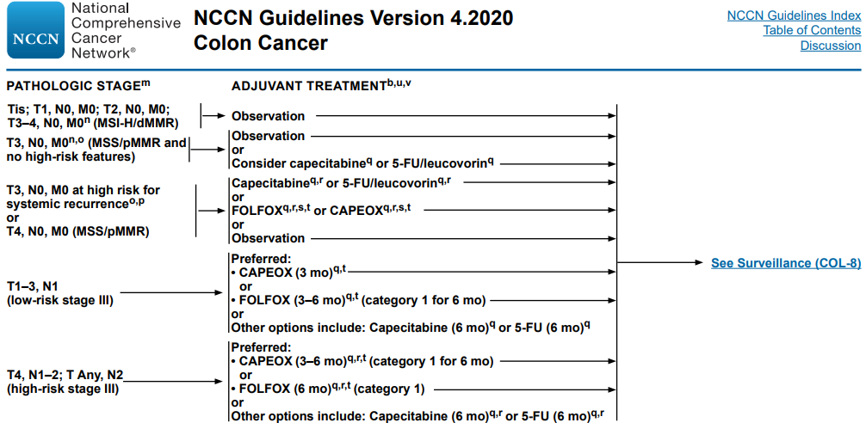

Slide 37
Concluding Thoughts
Individuals of African descent have higher incidence and mortality for colon cancer
This may be due to lifestyle factors and genetics as well as decreased screening.
Screening should be sought at age 45 for an individual of African descent without other risk factors
Family history of colon cancer, advanced polyps or genetic cancer syndromes may prompt earlier screening.
There are different options for screening, and the best option is the one that gets completed.
Maintain a healthy weight, exercise and ensure diet rich in fruits and vegetables.
Decrease processed foods, animal fat, and avoid a sedentary lifestyle.

Slide 38
Thank You

